Slide 1
Markov Model and Hidden Markov Model
19CSE305 ML

Slide 2
So far
Machine Learning- Terminology
Pre-processing & Data preparation
Linear Models
Tree based methods
Distance based methods
Probability based methods
Non-linear models

Slide 3
Sequential Data
So far, we have focussed primarily on sets of data points that were assumed to be independent and identically distributed
For many applications, however, the i.i.d. assumption will be a poor one- particularly for sequential data
Time series data, Speech data, DNA sequence, Text data,

Slide 4
Sequential Data
For many applications, (eg: financial forecasting, next word prediction) we wish to be able to predict the next value in a time series given observations of the previous values.
Intuitively, we expect that recent observations are likely to be more informative than more historical observations in predicting future values.
Can we consider whole history for making prediction? - Impractical!! (Why?)

Slide 5
Intuition
Can you predict next word?
What is your _______?
I eat a ______
The boy saw a ______
The ____ ______ ________ _____ ____________ _________ (try to generate a sentence)

Slide 6
Intuition
How we are predicting the words?
Based on the previous words
We can write it as a conditional probability:
What is your ___X____?
Prob (X|your)
If we are following a Bayes rule, we will select the one with maximum probability
What is the problem here?
name | 0.65
father | 0.15
problem | 0.25

Slide 7
Intuition
What is the problem here?
It always give the same results… right? (always static result)
But this is not true. The natural distribution is not always maximum likelihood.
There are many other factors - Eg: the generation should change with time
Probabilistic Models - Abstraction and Generation
Markov process and HMM

Slide 8
We will discuss
Markov assumption
Markov model
Hidden markov model
Applications

Slide 9
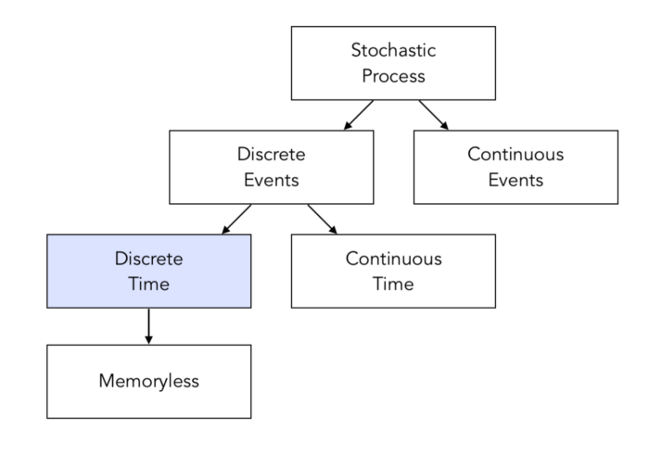
Markov Process
In Stochastic models (contrast to deterministic models) The same set of parameter values and initial conditions will lead to an ensemble of different outputs.
Markov Process is a stochastic model that obeys Markov property.

Slide 10
Markov Property
In a process wherein the next state depends only on the current state, such a process is said to follow Markov property.
Mathematically speaking, the conditional probability distribution of the next state depends on the current state and not the past states.
Prob (X_{t+1} | X₁,X₂,.....,X_{t}) = Prob (X_{t+1}|X_{t})
For many things in the real world behave sort of like Markov chains. We can think of examples of things where the immediate future mostly depends on the recent past rather than on all of history.
Eg: Election, Music Performance

Slide 11
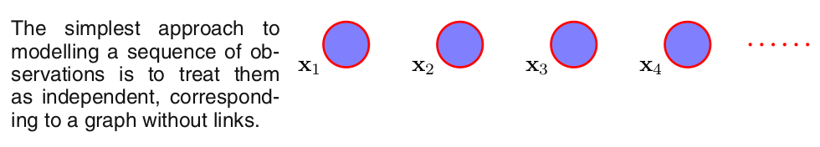

Slide 12
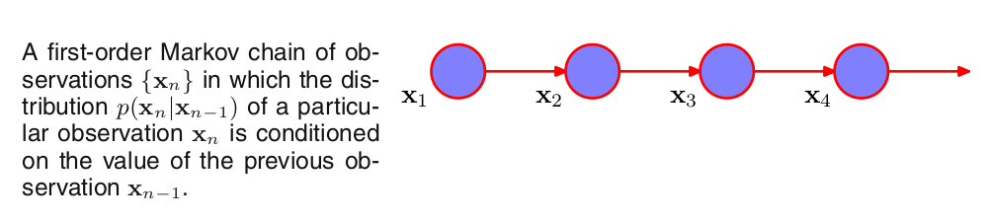

Slide 13
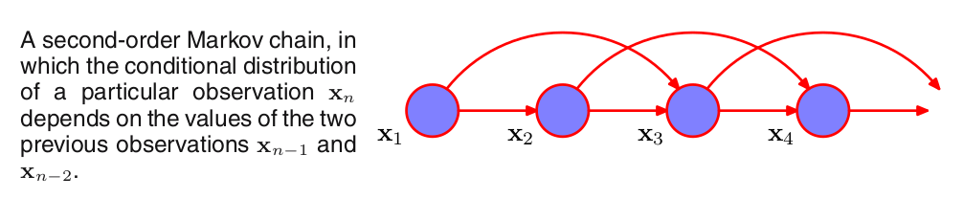

Slide 14
What is Markov Process
A Markov chain (MC)/Markov Process is a state machine that has a discrete number of states, q1, q2, . . . , qn, and the transitions between states are nondeterministic, i.e., there is a probability of transiting from a state qi to another state qj : P(St = qj | St−1 = qi ).
A markov model should satisfy
Probability axioms i.e., sum of all probabilities should be one: MC probability axiom
Markov property

Slide 15
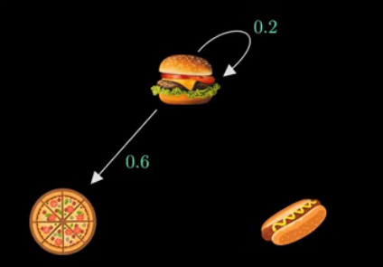
Example
Assume there is a restaurant that serve only 3 types of foods: Pizza, Burger and Hotdog
On any given day, it will serve only one item and that depends on what they served in previous day (or next day can be predicted from Today)
Burger, pizza and hot dogs are called states
The arrows are called transition
The probabilities are called transition probabilities

Slide 16
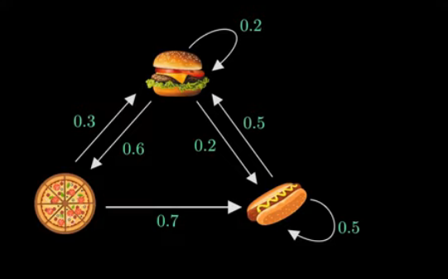
Example
Day-1: Pizza
Day-2: Burger
Day-3: Hotdog
Day-4: ?
Prob(Day4|Day1 to Day3) = Prob(Day4|Day3) (Markov Property)
Probabilities should sum to 1

Slide 17
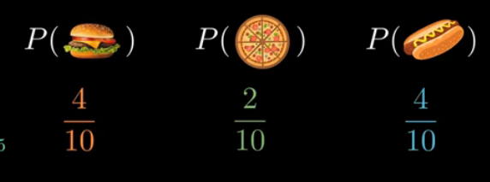
Example
Now let's have a random walk through the graph

Slide 18
Example
What will happen if we run for infinite time?
The transition diagram is considered a graph
Let A is the adjacency matrix (Transition matrix)
Let π denote initial probability: (say day-1 serves pizza)

Slide 19
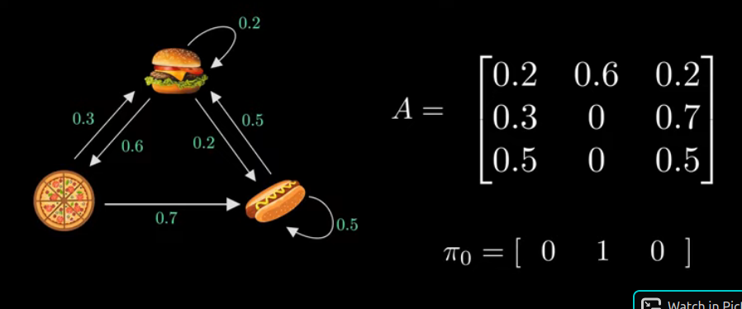

Slide 20
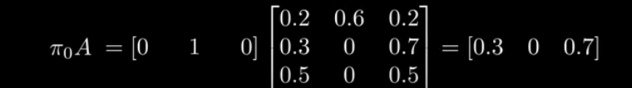
For the second day:
We can repeat this, until it converges: i.e. πA = π (solve using Linear Algebra)
Given this π and A, we can generate random sequences

Slide 21
Observable Markov Model
In an observable Markov model, the states are observable.
At any time t we know qt, and as the system moves from one state to another, we get an observation sequence that is a sequence of states.
The output of the process is the set of states at each instant of time where each state corresponds to a physical observable event.

Slide 22
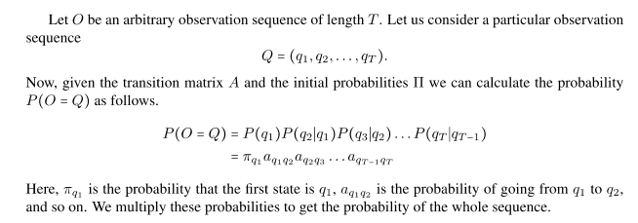

Slide 23
Hidden Markov Model
A Markov chain is useful when we need to compute a probability for a sequence of observable events.
In many cases, however, the events we are interested in arehidden: we don’t observe them directly.
A simple story will be better

Slide 24

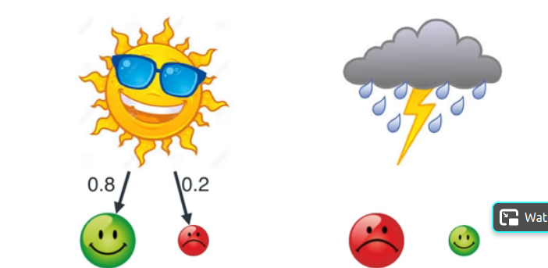

Slide 25

Alice assumes the weather from Bob’s mood

Slide 26
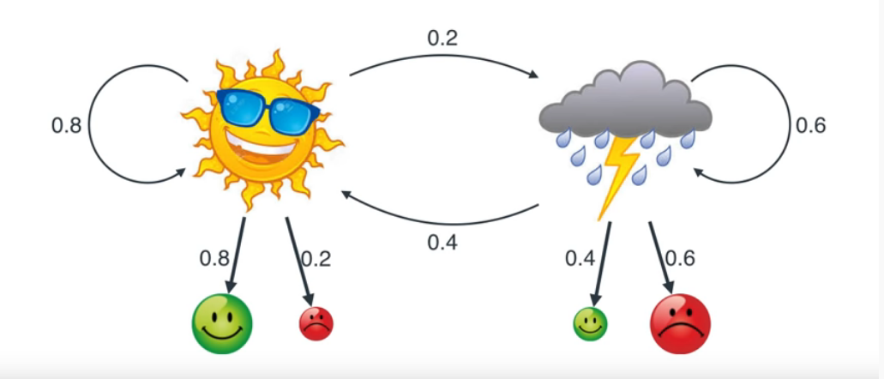
But weather depends on other factors- Hidden from Alice

Slide 27
Another example
We don’t normally observe hidden part-of-speech tags in a text. Rather, we see words, and must infer the tags from the word sequence

Slide 28
HMM
In hidden Markov model(HMM), the states (weather conditions) are not observable, but when hidden Markov model we visit a state, an observation (Bob’s mood) is recorded that is a probabilistic function of the state
HMMs allow us to compute the joint probability of a set of hidden states given a set of observed states. Once we know the joint probability of a sequence of hidden states, we determine the best possible sequence i.e. the sequence with the highest probability and choose that sequence as the best sequence of hidden states.

Slide 29
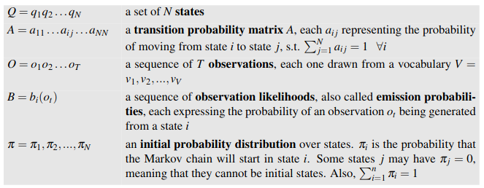
HMM -Definition

Slide 30
Three Problems in HMM
Problem 1 (Likelihood):Given an HMMλ= (A,B)and an observation sequence O, determine the likelihood P(O|λ). (Forward algorithm)
Problem 2 (Decoding):Given an observation sequence O and an HMM λ=(A,B), discover the best hidden state sequence Q. (Viterbi Algorithm)
Problem 3 (Learning):Given an observation sequence O and the set of states in the HMM, learn the HMM parameters A and B. (Baum-Welch algorithm)

Slide 31
The Evaluation Problem and the Forward Algorithm
We have a model M= (A, B,π ) and a sequence of observations O= (O1,...Ot), and, we have to found P(O|M)
Normal probability multiplication is exponential
But we can compute this probability using a dynamic programming method where we reuse the probability of partial sequence O1...Oi to compute O1..Oi+1.

Slide 32
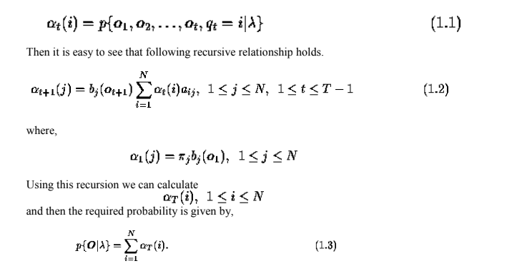
The Evaluation Problem and the Forward Algorithm

Slide 33
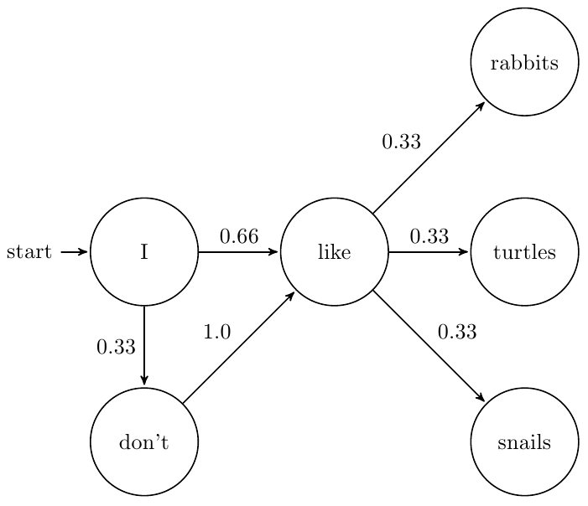
Applications of HMM
Word prediction/ sentence generation
POS Tagging

Slide 34
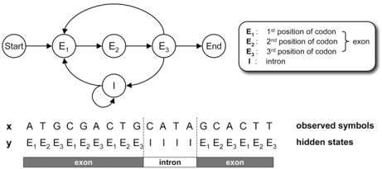
Applications of HMM
HMM in Bioinformatics
Gene Prediction
Protein structure prediction

Slide 35
Summary
Probabilistic Generative Models
Markov Process
HMM
Applications

Slide 36
Reference
Chapter 13, Pattern Recognition and Machine Learning, C. Bishop
Demo: https://setosa.io/ev/markov-chains/

Slide 37
Thank you

